Slide 1
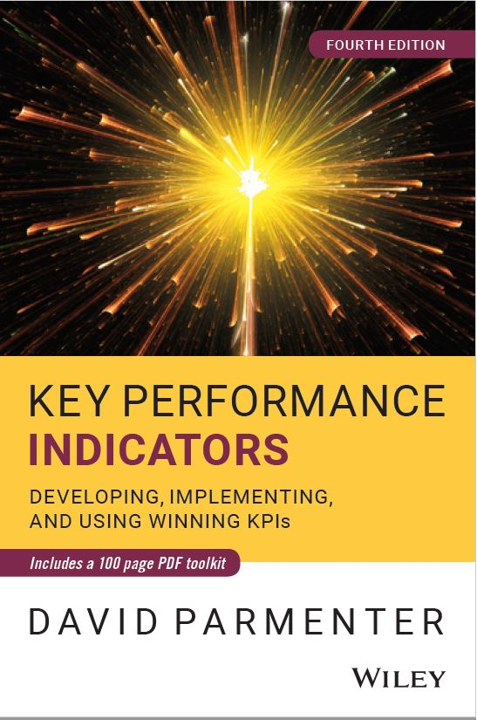
Transform your KPIs
Presented by ____________
Based on the work of David Parmenter
Website: www.davidparmenter.com

Slide 2
Around the world performance measurement has broken down
Measuring too much
Treat all measures as KPIs
A tendency to rely on financial measures
Relying on past measures
Driving dysfunctional behaviour
Notes:
How can all measures be Key Performance Indicators?
How can a monthly measure be KEY. For the horse has well and truly bolted.
Over reliance on financial measures yet they are the monetary value of an action that took place. It is the action that needs to be monitored more.
We drive our organisations by looking back in the past too much.
We have often ignored the impact of dysfunctional measures.

Slide 3
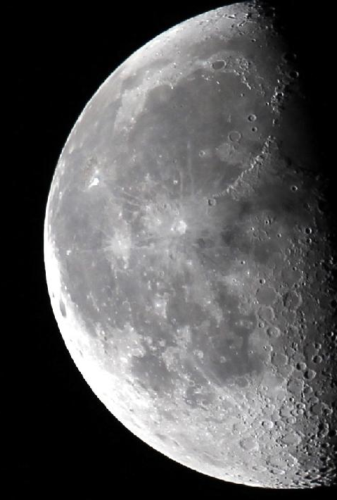
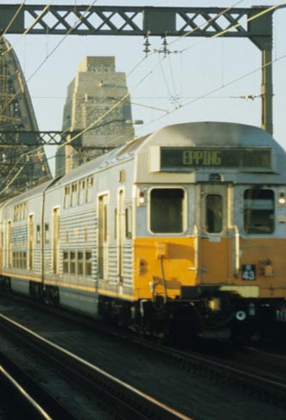
All measures have a dark side
Notes:
The moon and performance measures have a lot in common.

Slide 4
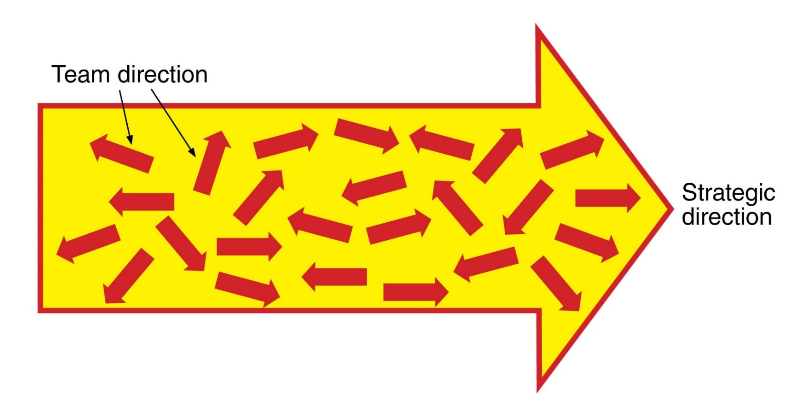
Organisations who work with KPIs still have a lack of alignment. They MEASURE, they REPORT and ACTIONS take place in the wrong direction.

Slide 5
Notes:
Nature on the other hand has achieved this alignment.

Slide 6
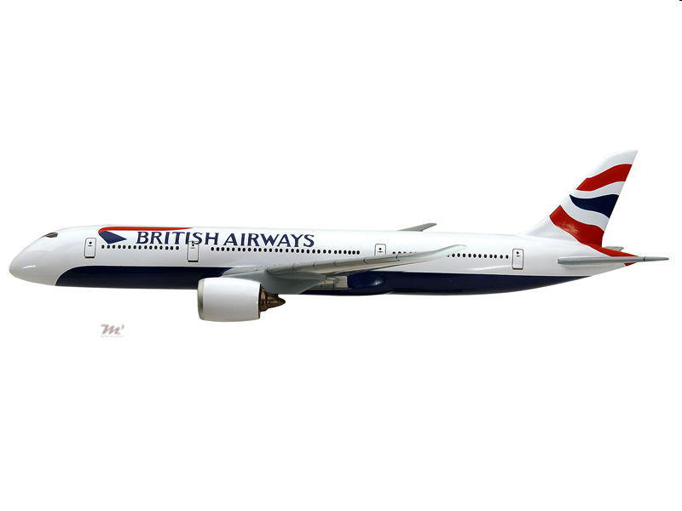
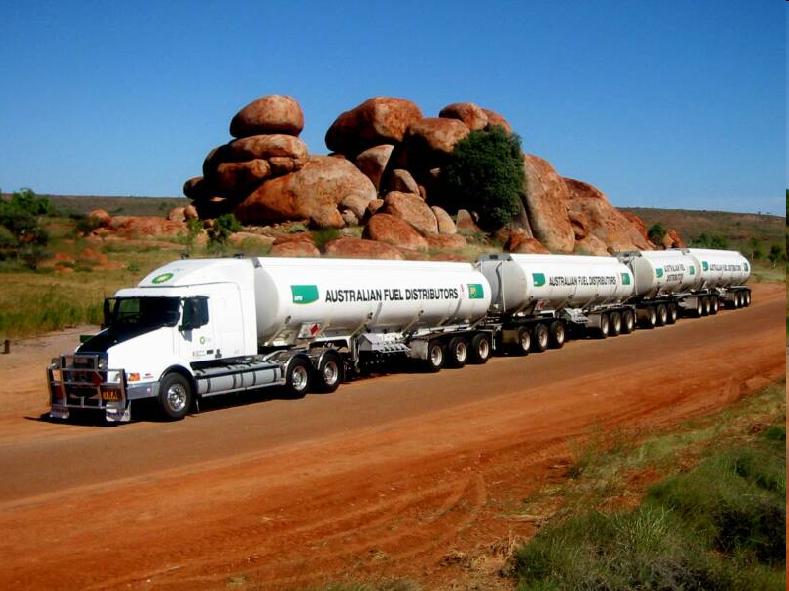
Stories
Airline
Freight forwarding company
What made these measures work?
who? what? why? when? where? how?
Notes:
This is an airline story. It is relevant to ________as it was for the European Space Agency, an Australian bank, A Singaporean Govt department, a forestry company in Nelson.
STORY (buy the toolkit)
Whenever you are getting confused refer back to this story. It was the key to my understanding of what are KPIs.
Managers and staff took action.
Fuel suppliers and catering were now informed about late plane priorities
Late passengers were not allowed to board e.g. like Ryan air.
The elderly and young were ushered on to the plane rather than getting lost in duty free shopping

Slide 7
What are key performance indicators?
Sphere of influence mapping using an airline’s success factors
The four types of performance measures
Transform your KPIs
Overview of the process
The characteristics of a KPI
Importance of knowing your organisation’s critical success factors
Notes:
If we accept not all measures can be called KPIs, what are the other types of measures called?

Slide 8
Two groups of two
Result Indicators | Measures that summarize the collective effort of a wide number of teams. Some I call Key Result Indicators.
Performance Indicators | Measures where the responsibility can be tied down to a team or a cluster of teams who work closely together. Some I call Key Performance Indicators.
Notes:
I want you to remember this picture.
Because measures are broken down into two groups of two

